Slide 1
Advanced Database Systems
Chapter 1 Query Processing and Optimization

Slide 2
Query Processing
Query is a request for data or information from a database table.
QP Is find information in one or more databases and deliver it to the user quickly and efficiently.
Databases containing more complex and diverse types of data demand new query processing and optimization techniques.
Query Processing can be divided into four main phases:
Decomposition:
Optimization
Code generation, and
Execution

Slide 3
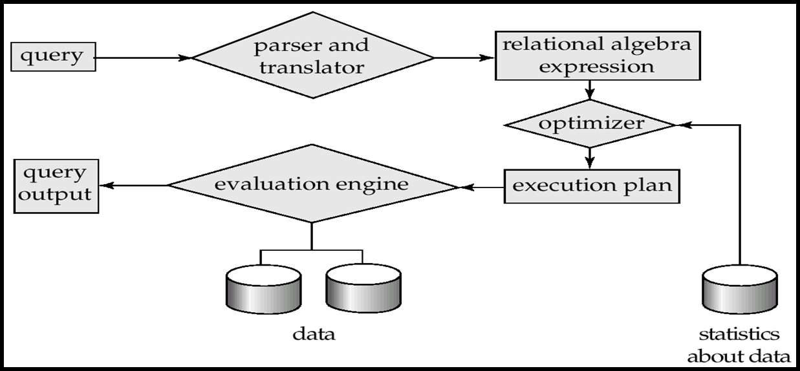
Query Processing Steps
Parser and Translator:-check correct query syntax and Schema elements.
Eg. SELECT empName from employee having name=‘”abc”
Having is invalid(where is correct )→syntax error
Assume emp.gmail is not available in the table;
Select emp.gmail from employee.→schema element error

Slide 4
…CON’T
Optimizer:
Find best plan to relational algebra
Finds all equivalent relational algebra
Find the expression with least cost
Statistics about data: is the size of relation
Number of blocks been used to store the relation
Number of records in the relation.
Number of index
Query Evaluation engine:
Evaluates the above plan and gets the results.
Is directly accessing data warehouse.

Slide 5
Phases of Query processing
Processing can be divided into :Decomposition, Optimization , and Execution ,Code generation
Query Decomposition
is the process of transforming a high level query into a relational algebra query, and to check that the query is syntactically and semantically correct.
Consists of parsing and validation
Typical stages in query decomposition are:
1) Analysis: lexical and syntactical analysis of the query (correctness).
Query tree will be built for the query containing leaf node for base relations, one or many non-leaf nodes for relations produced by relational algebra operations and root node for the result of the query.
Sequence of operation is from the leaves to the root.

Slide 6
…CON’T
2)Normalization: convert the query into a normalized form.
The predicate WHERE will be converted to Conjunctive (^) or Disjunctive (∨) Normal form.
3) Semantic Analysis: to reject normalized queries that are not correctly formulated or contradictory.
Incorrect if components do not contribute to generate result.
Contradictory if the predicate cannot be satisfied by any tuple.
Algorithms: relation connection graph and normalized attribute connection graph.
4) Simplification: to detect redundant qualifications, eliminate common sub-expressions, and transform the query to a semantically equivalent but more easily and effectively computed form.
5) Query Restructuring More than one translation is possible Use transformation rules.
Re arranging nodes so that the most restrictive condition will be executed first

Slide 7
…CON’T
Consider the following query from two relations; staff and branch
Staff ( StaffNo, name,position, salary, sex, BranchNo)
Branch (BranchNo,name, city)
Eg. Find all managers who manage a branch at Addis.
We can write this query in a SQL as follows
Select S.*
from staff s, branch b
where branchNo=s.branchNo AND
(S.position=’Manager’ AND b.city=’Addis’)

Slide 8
…CON’T
Assume
One record is accessed at a time, n staff , m branches, x non-manager, and y non-Addis branches for some integers n,m,x,y.
intermediate results are stored on disk
ignore about the final result(write) because it is the same for all the expressions
Then, this high level SQL can be transformed in the following three low level equivalent relational algebra expressions.
(position=’manager’)^(City=’Addis’ ) ^ (staff.branchNo=branch.branchNo₎(Staff X Branch)
Analysis:
read each tuple from the two relations →n+m reads
create a table of the Cartesian product→nXm writes
test each tuple of step 2→nXm read
Total No. of Disk access: →2(nXm) +n+m or

Slide 9
…CON’T
OR
(position=’manager’) ^ (City=’Addis’)(Staff staff.branchNo=branch.branchNo Branch)
Analysis:
i. read each tuple from the two relation→n+m reads
ii. create a table of the Join → n writes
iii. test each tuple of step 2 → n read
Total No. of Disk access: → 3(n) +m Or
(position =’manager’ (Staff )) staff.branchNo=branch.branchNo ( City=’Addis’(Branch))
Analysis:
i. Test each tuple from the two relations → n+m reads
ii. create a “manager_Staff” and “addis_Branch” realtions → (n-x) +(m-y) writes
iii. create a join of the two relations at step 2→ (n-x) + (m-y) reads
Total No. of Disk access: →2(n-x)+2(m-y)+n+m
Which of the expressions given above do you think is best (Optimal)?

Slide 10
…CON’T
Assume:
1000 tuples in Staff.
50 Managers
50 tuples in Branch.
5 London branches
No indexes or sort keys
All temporary results are written back to disk (memory is small)
Tuples are accessed one at a time (not in blocks)

Slide 11
…CON’T
Query 1 (Bad)
σ(position=‘Manager’)^(city=‘London’)^(Staff.branchNo=Branch.branchNo) (Staff X Branch)
Requires (1000+50) disk accesses to read from Staff and Branch relations
Creates temporary relation of Cartesian Product (1000*50) tuples
Requires (1000*50) disk access to read in temporary relation and test predicate
Total Work = (1000+50) + 2*(1000*50) =
101,050 I/O operations
Query 2 (Better)
σ(position=‘Manager’)^(city=‘London’) (Staff wvStaff.branchNo = Branch.branchNo Branch)
Again requires (1000+50) disk accesses to read from Staff and Branch
Joins Staff and Branch on branchNo with 1000 tuples
(1 employee : 1 branch )
Requires (1000) disk access to read in joined relation and check predicate
Total Work = (1000+50) + 2*(1000) =
3050 I/O operations
33% Improvement over Query 1

Slide 12
…CON’T
Query 3 (Best)
[ σ_{(position=‘Manager’)} (Staff) ] wvStaff.branchNo = Branch.branchNo
[ σ_{(city=‘London’)} (Branch) ]
Read Staff relation to determine ‘Managers’ (1000 reads)
Create 50 tuple relation(50 writes)
Read Branch relation to determine ‘London’ branches (50 reads)
Create 5 tuple relation(5 writes)
Join reduced relations and check predicate (50 + 5 reads)
Total Work = 1000 + 2*(50) + 5 + (50 + 5) =
1160 I/O operations
8700% Improvement over Query 1

Slide 13
Query Optimization
What is wrong with the ordinary query?
Everyone wants the performance of their database to be optimal.
In particular, there is often a requirement for a specific query or object that is query based, to run faster.
Problem of query optimization is to find the sequence of steps that produces the answer to user request in the most efficient manner, given the database structure.
The performance of a query is affected by the tables or queries that underlies the query and by the complexity of the query.
When data/workload characteristics change
The best navigation strategy changes
The best way of organizing the data changes

Slide 14
…CON’T
Query optimizers are one of the main means by which modern database systems achieve their performance advantages.
Given a request for data manipulation or retrieval, an optimizer will choose an optimal plan for evaluating the request from among the many alternative strategies.
i.e. there are many ways (access paths) for accessing desired file/record.
The optimizer tries to select the most efficient (cheapest) access path for accessing the data.
DBMS is responsible to pick the best execution strategy based various considerations.
Query optimizers were already among the largest and most complex modules of database systems.

Slide 15
…CON’T
Most efficient processing: Least amount of I/O and CPU resources.
Selection of the best method: In a non-procedural language the system does the optimization at the time of execution.
For optimizing the execution of a query the programmer must know:
File organization
Record access mechanism and primary or secondary key.
Data location on disk.
Data access limitations.
To write correct code, application programmers need to know how data is organized physically (e.g., which indexes exist)
To write efficient code, application programmers also need to worry about data/workload characteristics
One has to cope with change! (Real time changes hence, preferable to give the responsibility of optimization to the DBMS).

Slide 16
…CON’T
Example: Consider relations r(AB) and s(CD). We require r X s.
Method 1
Load next record of r in RAM.
Load all records of s, one at a time and concatenate with r.
All records of r concatenated?
NO: goto a.
YES: exit (the result in RAM or on disk).
Performance: Too many accesses.
Method 2: Improvement
Load as many blocks of r as possible leaving room for one block of s.
Run through the s file completely one block at a time.
Performance: Reduces the number of times s blocks are loaded by a factor of equal to the number of r records than can fit in main memory.
Considerations during query Optimization:
Narrow down intermediate result sets quickly. SELECT before JOIN
Use access structures (indexes).

Slide 17
Approaches to Query Optimization
Heuristics Approach
Uses the knowledge of the characteristics of the relational algebra operations and the relationship between the operators to optimize the query.
Thus the heuristic approach of optimization will make use of:
Properties of individual operators
Association between operators
Query Tree: a graphical representation of the operators, relations, attributes and predicates and processing sequence during query processing.

Slide 18
…CON’T
Query tree is composed of three main parts:
The Leafs: the base relations used for processing the query/ extracting the required information
The Root: the final result/relation as an output based on the operation on the relations used for query processing
Nodes: intermediate results or relations before reaching the final result.
Sequence of execution of operation in a query tree will start from the leaves and continues to the intermediate nodes and ends at the root.
The properties of each operations and the association between operators is analyzed using set of rules called TRANSFORMATION RULES.
Use of the transformation rules will transform the query to relatively good execution strategy.
18

Slide 19
Transformation Rules for Relational Algebra
1. Cascade of SELECTION: conjunctive SELECTION Operations can cascade into individual Selection Operations and Vice Versa
 (c1ʌc2ʌc3) (R)= c1(c2(c3(R)) where ci is a predicate
2. Commutativity of SELECTION operations
c1(c2(R))= c2(c1(R)) where ci is a predicate
3. Cascade of PROJECTION: in the sequence of PROJECTION Operations, only the last in the sequence is required
L1 L2 L3 L4(R) = L1(R)
4. Commutativity of SELECTION with PROJECTION and Vise Versa
If the predicate c1 involves only the attributes in the projection list (L1), then the selection and projection operations commute
<a1,a2..an>(c1(R))=c1(<a1,a2,,,,an>(R))
Where c1€{a1,a2…an}

Slide 20

…CON’T
5. Commutativity of THETA JOIN/Cartesian Product
R X S is equivalent to S X R
Also holds for Equi-Join and Natural-Join
6. Commutativity of SELECTION with THETA JOIN
a. If the predicate c1 involves only attributes of one of the relations (R) being joined, then the Selection and Join operations commute
b. If the predicate is in the form c1 ʌ c2 and c1 involves only attributes of R and c2 involves only attributes of S, then the Selection and Theta Join operations commute

Slide 21
…CON’T
7. Commutativity of PROJECTION and THETA JOIN
If the projection list is of the form L1, L2, where L1 involves only attributes of R and L2 involves only attributes of S being joined and the predicate c involves only attributes in the projection list, then the PROJECTION and JOIN operations commute as:
However if the join condition c contains additional attributes not in projection list L=L₁ U L₂ , say M=M₁U M₂ where M₁ is from R and M₂ is from S then the PROJECTION and JOIN operations commute as follows:
8. Commutativity of the Set Operations: UNION and INTERSECTION but not SET DIFFERENCE:

Slide 22
…CON’T
9. Associativity of the THETA JOIN, CARTESIAN PRODUCT, UNION and INTERSECTION.
10. Commuting SELECTION with SET OPERATIONS
11. Commuting PROJECTION with UNION

Slide 23
…CON’T
Heuristic Approach will be implemented by using the above transformation rules in the following sequence or steps.
Sequence for Applying Transformation Rules
1. Use
Rule-1→ Cascade SELECTION
2. Use
Rule-2: Commutativity of SELECTION
Rule-4: Commuting SELECTION with PROJECTION
Rule-6: Commuting SELECTION with JOIN and CARTESIAN
Rule-10: commuting SELECTION with SET OPERATIONS

Slide 24
…CON’T
3. Use
Rule-9: Associativity of Binary Operations (JOIN, CARTESIAN, UNION and INTERSECTION). Rearrange nodes by making the most restrictive operations to be performed first (moving it as far down the tree as possible)
4. Perform Cartesian Operations with the subsequent Selection Operation
5. Use
Rule-3: Cascade of PROJECTION
Rule-4: Commuting PROJECTION with SELECTION
Rule-7: Commuting PROJECTION with JOIN and CARTESIAN
Rule-11: commuting PROJECTION with UNION

Slide 25
Main Heuristic
The main heuristic is to first apply operations that reduce the size (the cardinality and/or the degree) of the intermediate relation.
That is:
a. Perform SELECTION as early as possible: that will reduce the cardinality (number of tuples) of the relation.
b. Perform PROJECTION as early as possible: that will reduce the degree (number of attributes) of the relation.
Both a and b will be accomplished by placing the SELECT and PROJECT operations as far down the tree as possible.
c. SELECT and JOIN operations with most restrictive conditions resulting with smallest absolute size should be executed before other similar operations.
This is achieved by reordering the nodes with JOIN.
25

Slide 26
…CON’T
Example: consider the following schemas and the query, where the EMPLOYEE and the PROJECT relations are related by the WORKS_ON relation.
EMPLOYEE (EEmpID, FName, LName, Salary, Dept, Sex, DoB)
PROJECT (PProjID, PName, PLocation, PFund, PManagerID)
WORKS_ON (WEmpID, WProjID)
WEmpID (refers to employee identification) and PProjID (refers to project identification) are foreign keys to WORKS_ON relation from EMPLOYEE and PROJECT relations respectively.

Slide 27
…CON’T
Query: The manager of the company working on road construction would like to view employees name born before January 1 1965 who are working on the project named Ring Road.
Relational Algebra representation of the query will be:
<FName, LName> (<DoB<Jan 1 1965 ʌ WEmpID = EEmpID ʌ PProjID=WProjID ʌ PName=’Ring Road’> (EMPLOYEE X WORKS_ON X PROJECT))

Slide 28
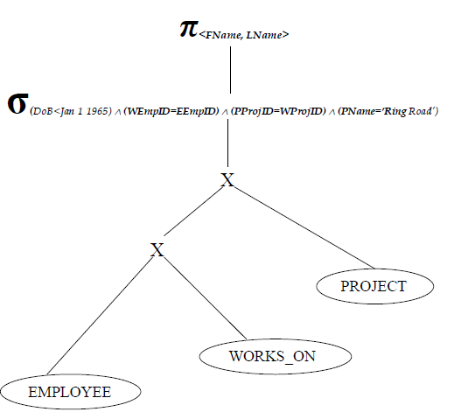
…CON’T
The SQL equivalence for the above query will be:
SELECT FName, LName FROM EMPLOYEE, WORKS_ON, PROJECT WHERE DoB<Jan 1 1965 ʌ EEmpID=WEmpID ʌ WProjID=PProjID ʌ PName=”Ring Road”
The initial query tree will be:

Slide 29
…CON’T
By applying the first step (cascading the selection) we will come up with the following structure.
(DoB<Jan 1 1965)
((WEmpID=EEmpID)((PProjID=WProjID)((PName=’Ring Road’) (EMPLOYEE X WORKS_ON X PROJECT ) ) )
By applying the second step it can be seen that some conditions have attribute that belong to a single relation (DoB belongs to EMPLOYEE and PName belongs to PROJECT) thus the selection operation can be commuted with Cartesian Operation.
Then, since the condition WEmpID=EEmpID base the employee and WORKS_ON relation the selection with this condition can be cascaded.

Slide 30
…CON’T
The query tree after this modification will be:

<
FName, LName
>

(
)
PProjID=WProjID
X


(
WEmp
ID=EEmpID
)
(
PName=’Ring
Road’
)
X
PROJECT

(
DoB<Jan
1 1965
WORKS_ON
)
EMPLOYEE

Slide 31
…CON’T
Using the third step, perform most restrictive operations first.
From the query given we can see that selection on PROJECT is most restrictive than selection on EMPLOYEE.
Thus, it is better to perform selection on PROJECT BEFORE on EMPLOYEE. rearrange the nodes to achieve this.

Slide 32

<
>
FName, LName

(
)
WEmpID=EEmpID
X


(
)
PProjID=WProjID
(
DoB<Jan
1 1965
)
EMPLOY
X
EE

(
PName=’Ring
WORKS_ON
Road
’)
PROJECT

Slide 33


Using the forth step, Perform Join Operations with the subsequent Selection Operation.

<
FName, LName
>
(
WEmpID=EE
mpID
)

(
DoB<Jan
1 1965
)
(
PProjID=WProjID
)
EMPLOY
EE

(
PName=’Ring Road ‘)
WORKS_ON
PROJECT

Slide 34


Using the fifth step, Perform the projection as early as possible.

<
>
FName, LName
(
WEmpID=EEmpID
)

<
>
WEmpID

(
PProjID=WProjID
<
FName,LName,EEmpID>
)

(
DoB<Jan
1 1965
)
WORKS_ON

EMPLOY
<
PProjID
EE
>

(
PName=’Ring
Road
’)
PROJECT

Slide 35
Cost Estimation Approach to Query Optimization
The main idea is to minimize the cost of processing a query.
The cost function is comprised of:
I/O cost + CPU processing cost + communication cost + Storage cost
These components might have different weights in different processing environments.
The DBMS will use information stored in the system catalogue for the purpose of estimating cost.
The main target of query optimization is to minimize the size of the intermediate relation.
The size will have effect in the cost of:
Disk Access
Data Transpiration
Storage space in the Primary Memory
Writing on Disk

Slide 36
…CON’T
The statistics in the system catalogue used for cost estimation purpose are:
Cardinality of a relation: the number of tuples contained in a relation currently (r)
Degree of a relation: number of attributes of a relation
Number of tuples on a relation that can be stored in one block of memory
Total number of blocks used by a relation
Number of distinct values of an attribute (d)
Selection Cardinality of an attribute (S): that is average number of records that will satisfy an equality condition S=r/d
By seeing the above information one could calculate the cost of executing a query and selecting the best strategy, which is with the minimum cost of processing.

Slide 37
Cost Components for Query Optimization
The costs of query execution can be calculated for the following major process we have during processing.
1) Access Cost of Secondary Storage
Data is going to be accessed from secondary storage, as an query will be needing some part of the data stored in the database.
The disk access cost can again be analyzed in terms of:
Searching
Reading, and
Writing, data blocks used to store some portion of a relation.
The disk access cost will vary depending on the file organization used and the access method implemented for the file organization.

Slide 38
…CON’T
2) Storage Cost
While processing a query, as any query would be composed of many database operations, there could be one or more intermediate results before reaching the final output.
These intermediate results should be stored in primary memory for further processing.
The bigger the intermediate relation, the larger the memory requirement, which will have impact on the limited available space.

Slide 39
…CON’T
3) Computation Cost
Query is composed of many operations.
The operations could be database operations like reading and writing to a disk, or mathematical and other operations like:
Searching
Sorting
Merging
computation on field values
4) Communication Cost
In most database systems the database resides in on station and various queries originate from different terminals.
This will have impact on the performance of the system adding cost for query processing.
Thus, the cost of transporting data between the database site and the terminal from where the query originate should be analyzed.

Slide 40


